Slide 1






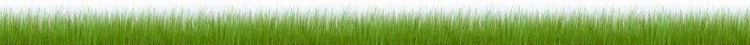
Welcome
Community Backyards Thanks the Following Communities & Partners
Bexley • Canal Winchester • Columbus • Dublin • Franklin County • Gahanna • Grandview • Grove City • Hilliard
New Albany • Obetz • Reynoldsburg • Upper Arlington • Westerville • Whitehall • Worthington

Slide 2
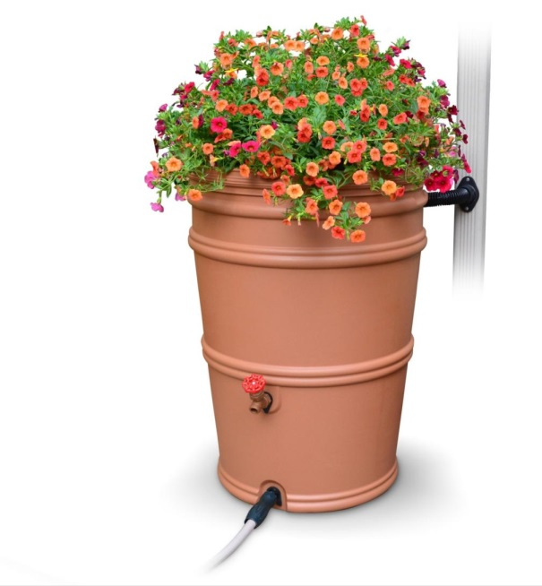
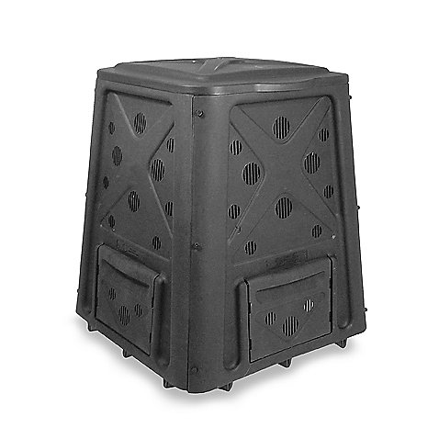
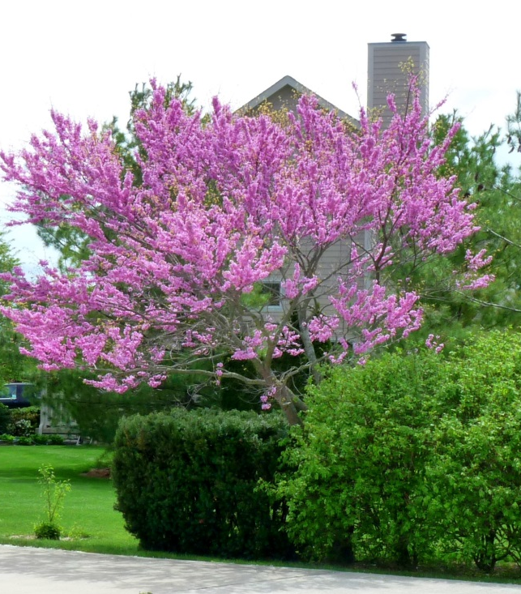
$how me the money!!
Offering reimbursements on one of the eligible items below
Rain barrel with diverter
Enclosed Composter
Native Perennials, Shrubs, and Trees
Notes:
Together with our partners, Franklin Soil and Water offers eligible residents $50 reimbursements for the purchase of an approved rain barrel, compost bin, or native plants and trees from a licensed retailer within the current year of participation. The Community Backyards program is available to City of Columbus residents, participating municipalities, and Franklin County residents.

Slide 3
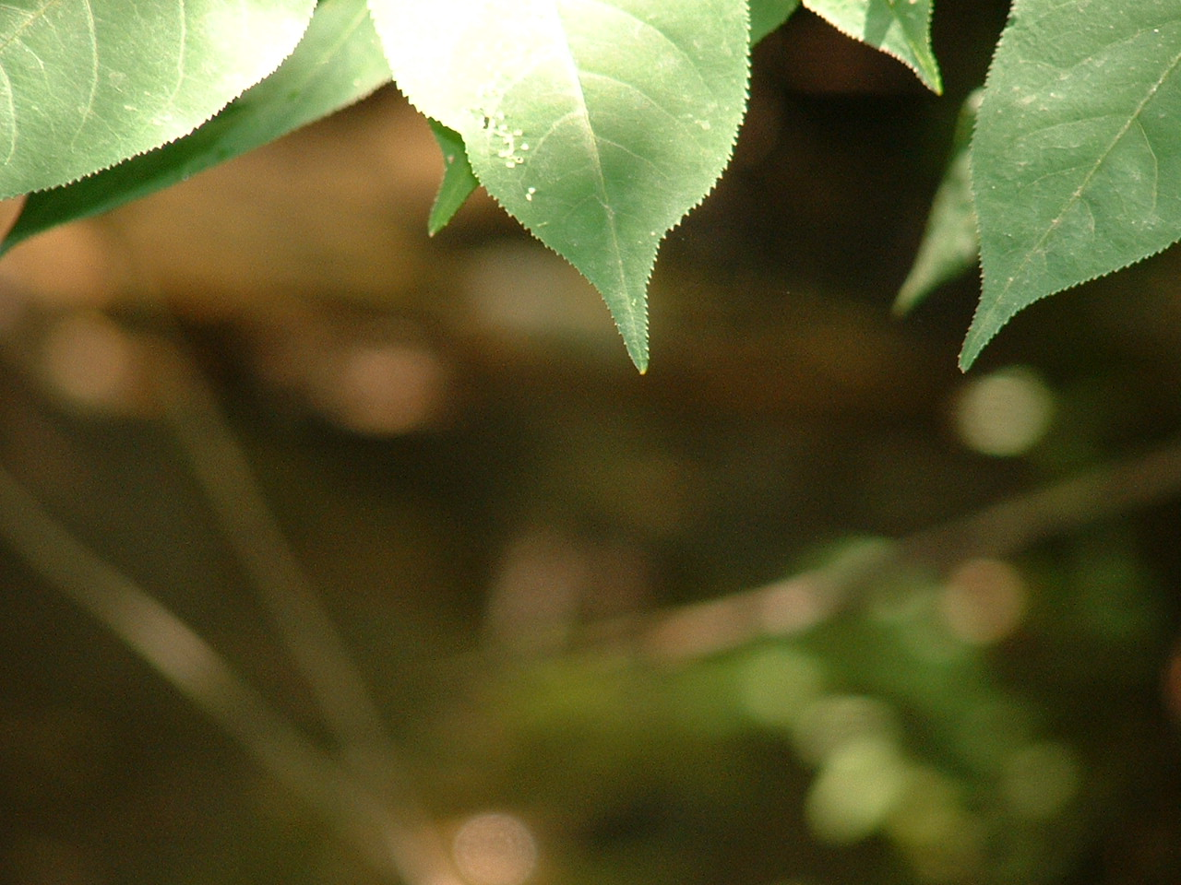
Community Backyards
Program Overview
Benefits of Backyard Conservation
Rain gardens and rain barrels
reduce runoff and treat water as a resource
Composting
saves landfill space and enriches garden soil
Planting natives
is essential for animals that depend on them
Proper lawncare
means less watering and weeding

Slide 4
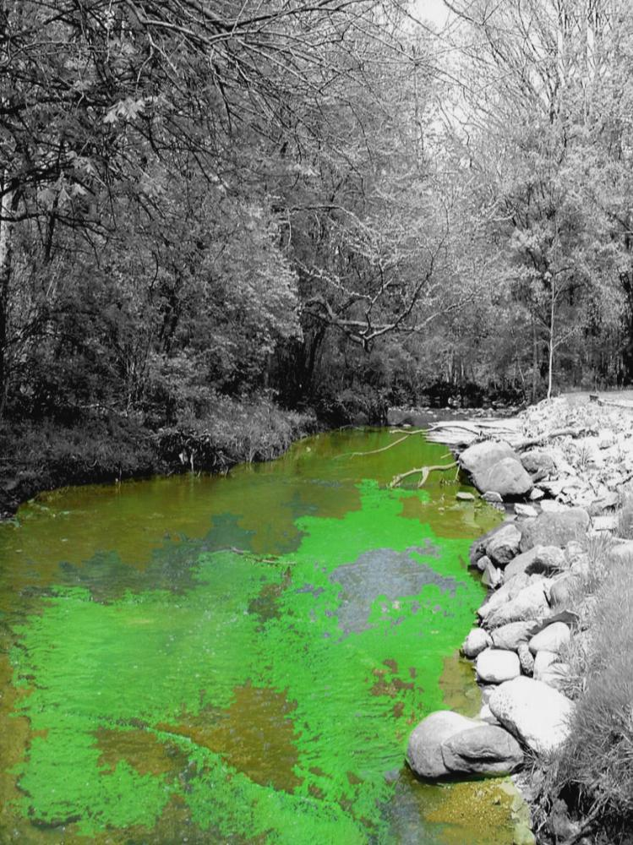
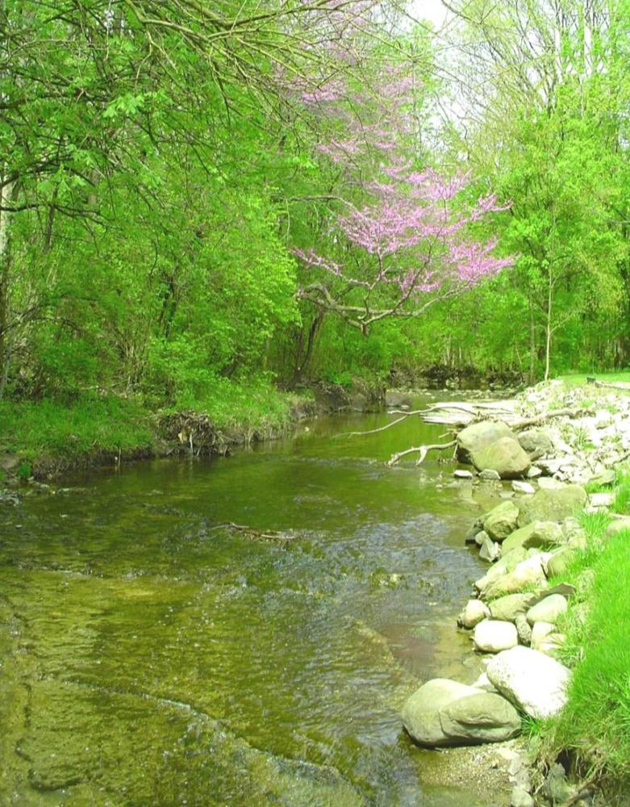
The Goal of Community Backyards
To improve water quality by reducing stormwater runoff
Notes:
Community Backyards is an educational program promoting stormwater awareness and education within Franklin County. Keeping rain where it falls and using it as a resource keeps our watersheds healthy and safe. We continue to promote the use of rain barrels and rain gardens, while introducing residents to backyard conservation practices including composting, using native plants and trees in the landscape, and responsible lawn care.

Slide 5
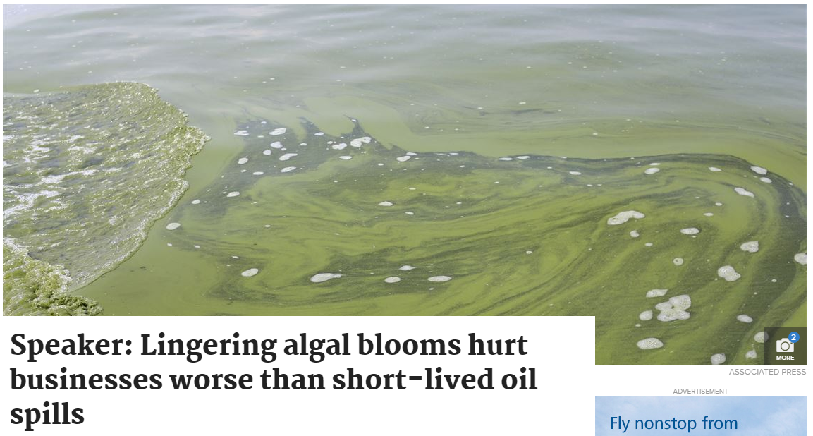
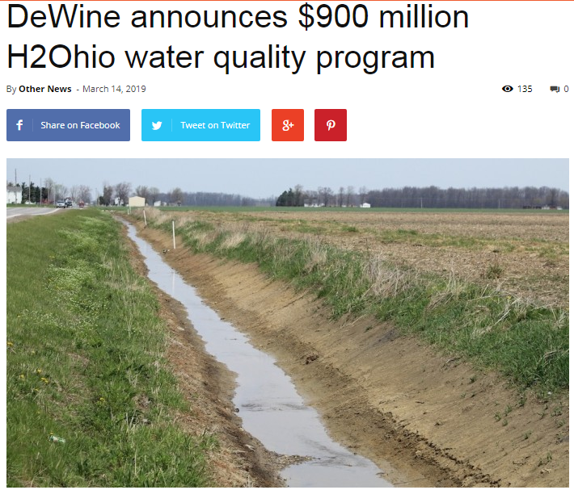
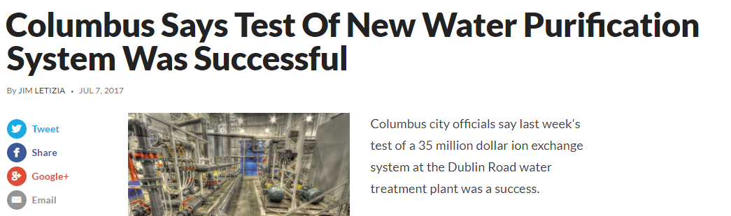
Implications of runoff
Notes:
Share pollution caused by ag and/or aging infrastructure but don’t let people freak out. We’re good at cleaning water, but it’s not cheap and water is a non-renewable resource.
Columbus says test of new water purification system was successful
After two straight years of nitrate warnings, during which water in certain areas of the city were not drinkable, the city invested $35 million in an ion exchange system to remove nitrates. While there hasn’t been a nitrate warning since, the City still continues to battle sources of nitrate pollution since the ion exchanger can cost up to $65,000/day it is running.
2. Dewine Announces $900 million H2Ohio water quality program- https://www.farmanddairy.com/news/dewine-announces-900-million-h2ohio-water-quality-program/542390.html
Will fund three efforts- Prevention and land-based management programs, such as funding efforts to minimize the introduction of nutrients and other runoff into Ohio waterways, additional staffing at soil and water conservation districts, and more aggressive action to address failing septic systems and other water treatment needs across Ohio.
Water-based restoration programs, such as the creation of more wetlands in targeted areas to naturally filter out nutrients and sediment and utilizing emerging technologies to minimize water quality problems and treat polluted water.
Science, research and measurement, such as supporting ongoing research and data collection to advise on metrics and measurable goals, and to stay updated on and utilize new prevention and treatment technologies.
2. Lingering algal blooms hurt businesses worse than short-lived oil spills- https://www.toledoblade.com/local/environment/2019/01/28/chronic-lingering-algal-blooms-hurt-business-community-worse-than-short-lived-oil-spills/stories/20190128130
The new wave of western Lake Erie’s chronic algal blooms began in 1995, although this region is not unique in that regard.
Scientists have documented a rise throughout the world, assigning blame to climate change and poor farming and development practices that have allowed more algae-growing nutrients into the water. The global outbreak has become one of the hottest research topics in North America, Asia, Africa, and other continents.
But in terms of public perception, chronic algal blooms can do more harm than an occasional oil spill, Ms. Huntley said.

Slide 6
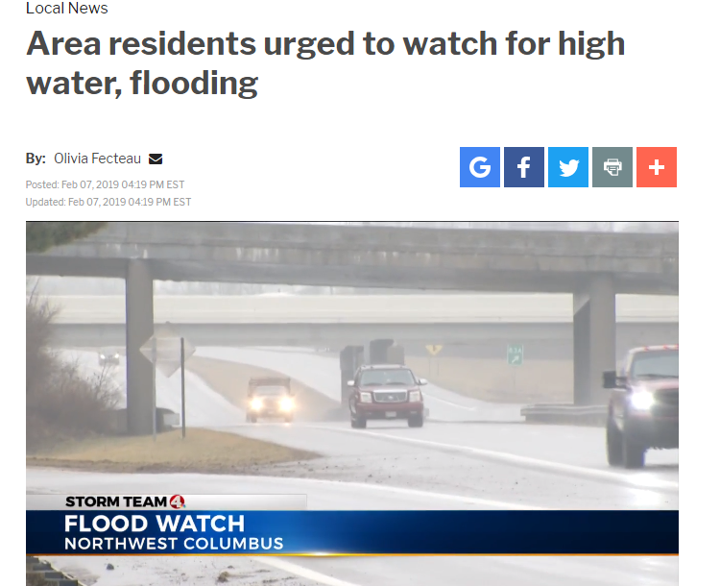

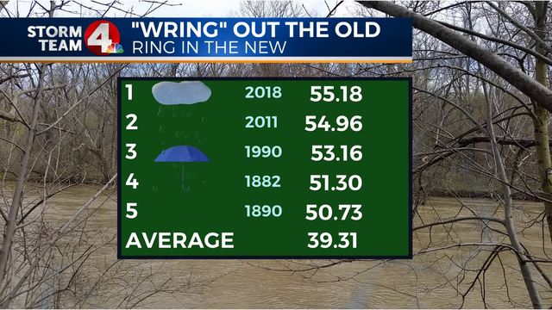
The Water Cycle… Interrupted
+ Climate Change in Midwest
Notes:
Localized flooding, worsened by climate change. In 15 out of the last 20 years, annual precipitation in OH exceeded the 20th-century average. The amount of precipitation falling during intense multi-day events has increased in the Midwest US. Due to increasing temperatures, there will be more rain and less snow. Its more important than ever to think about how we manage weather’s effect on our home, property, environment, and drinking water.
https://www.dispatch.com/news/20181231/columbus-has-passed-all-time-annual-precipitation-record
https://www.nbc4i.com/news/local-news/area-residents-urged-to-watch-for-high-water-flooding/1762981780
3. https://www.cincinnati.com/story/news/2019/03/05/landslides-climate-change-bring-more-cincinnati/2931026002/

Slide 7
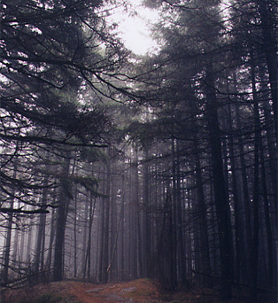
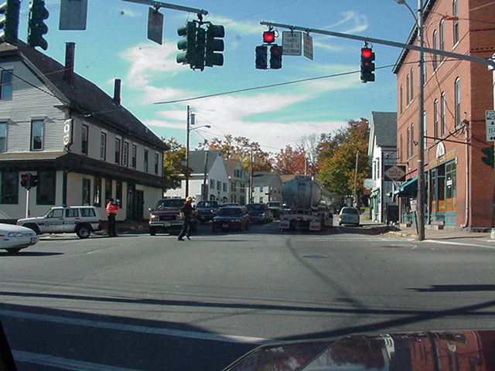

Changes to Water Cycle
Natural Ground Cover
75-100% Impervious Surface
Evaporation
40%
Evaporation
Runoff
Runoff
30%
Infiltration
10%
50%
Infiltration
55%
15%

Slide 8
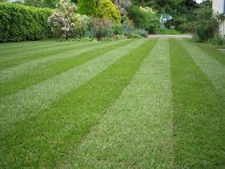
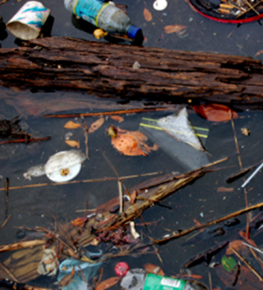
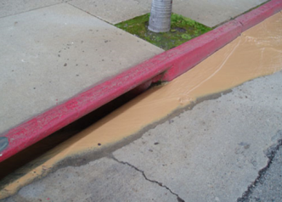
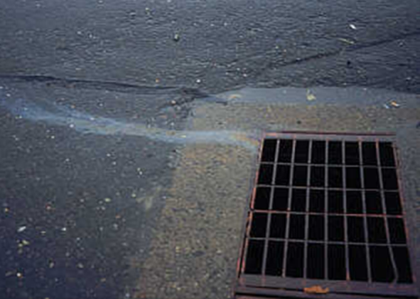
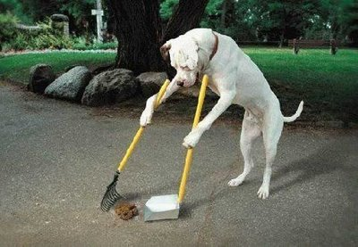
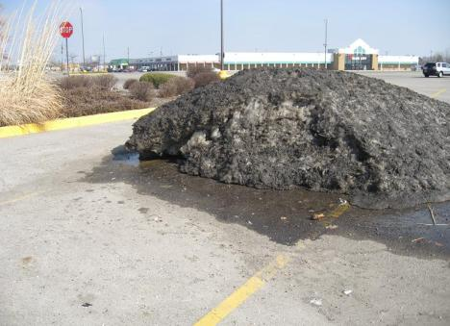
Benefits: water quality/quantity
Litter
Fertilizers, pesticides
Sediment
Vehicular fluids
Fido
Combined frozen grossness
Notes:
Pollutant removal mechanism

Slide 9
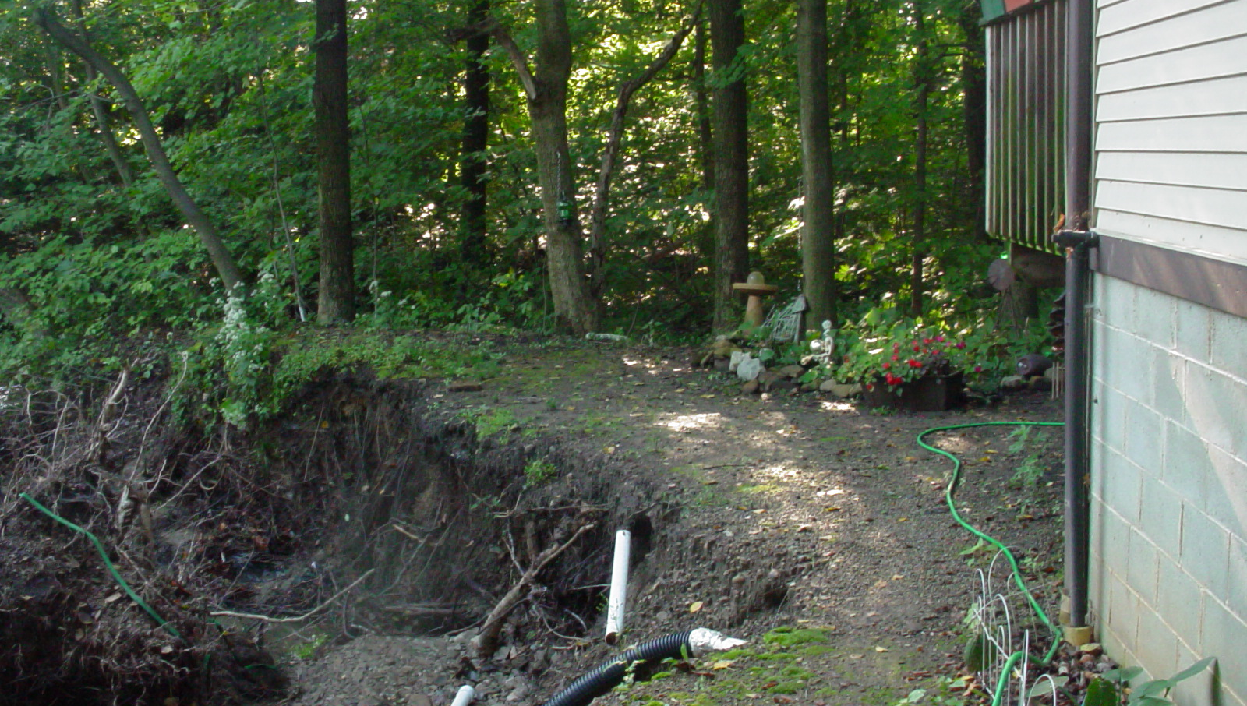
Benefits: water quality/quantity
Impacts include increased stream erosion and flooding, which can threaten properties, homes, and roads. Increased runoff also impacts stream habitat and water temperature. Higher water temperature results in less oxygen for fish.

Slide 10
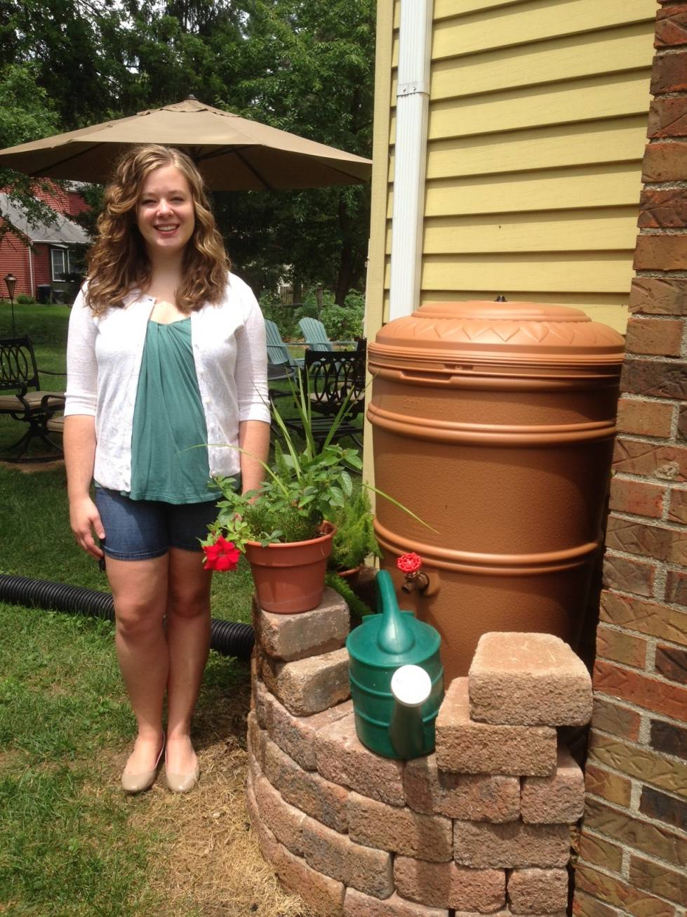
Rain Barrels
Photo permission of Chelsea Donelson,
Gahanna
Rain Barrel Recipient*
*happiness not included with purchase
of rain barrel

Slide 11


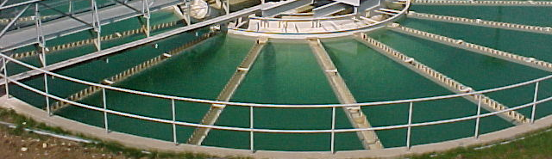
Benefits of Rain Barrels
Free Water!
Plants Prefer Soft Water
Low-cost Practice
Closed System
Water Conservation
Child Friendly

Slide 12
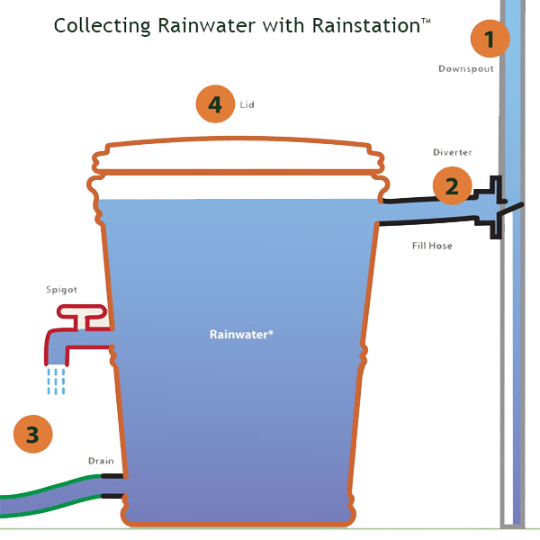
How Do Rain Barrels Work?
Rain falls through downspout from rooftop
1
Diverter directs rainwater into barrel. When the barrel is full, excess water passes through downspout to prevent overflow
2
Spigot makes it easy to fill watering cans. Drain lets you empty rain barrel and attach hose for watering beds
3
Non-Potable
Lids are for safety and prevent materials from clogging barrel
4
Rain barrel models differ! Your local ordinance may require you to have a diverter. Only rain barrels with connected & level diverters will be reimbursed through Community Backyards.

Slide 13
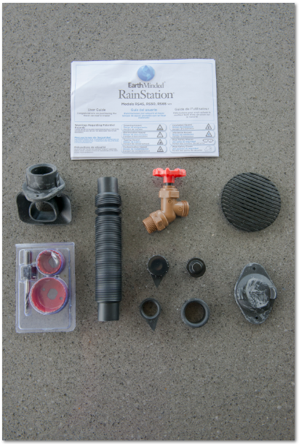
Rain Barrel Components
Diverters are required for reimbursement!
Installation Directions
(to disregard entirely)
Typical Rain Barrel Components
Diverter
2 Piece hole saw
Fill hose
Drain plug, cap, and seal
Winterization hole cover
Hose seal(s)
Planter top filler

Slide 14
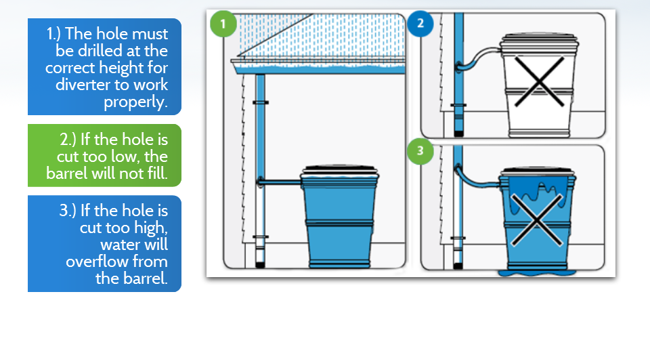
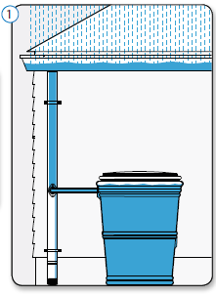
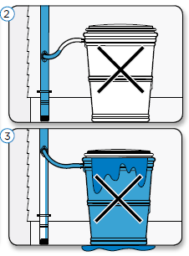
Installation
Follow directions that are included
Always keep on a level surface
1
2
3
1
The hole must be drilled at the correct height for diverter to work properly.
If the hole is cut too low, the barrel will not fill.
If the hole is cut too high, water will overflow from the barrel.
2
3

Slide 15
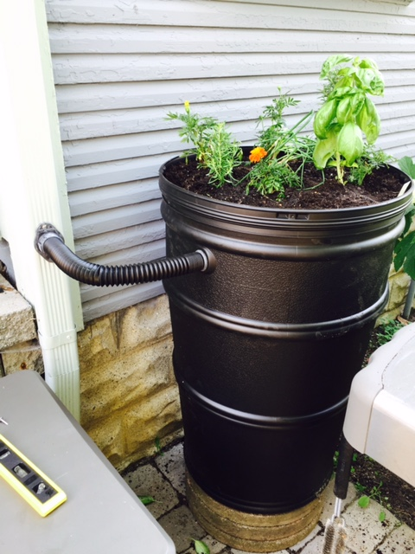
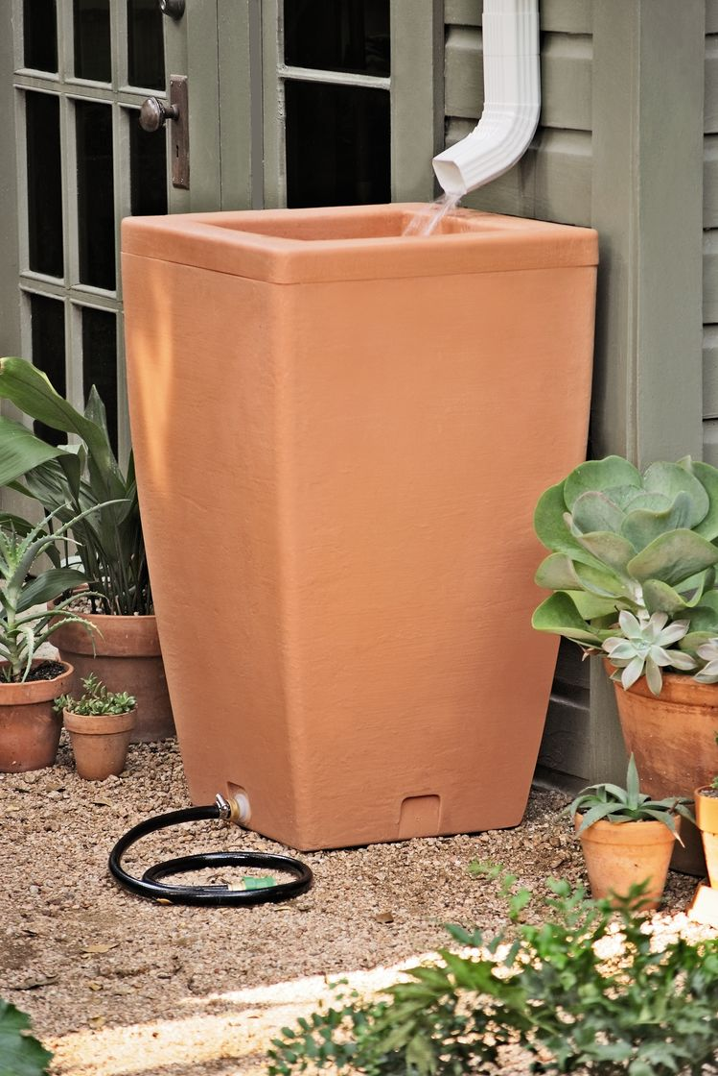
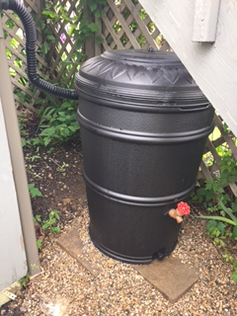
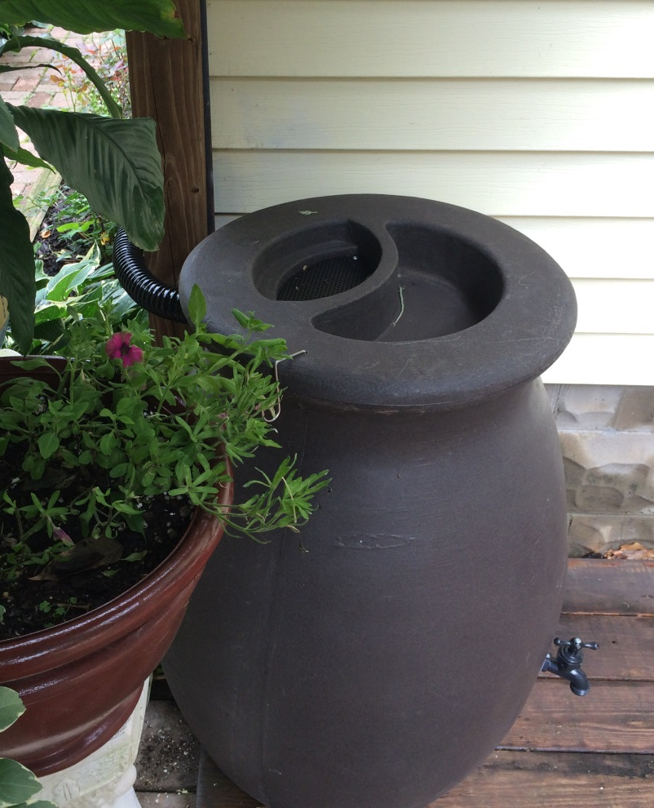
Let’s See If You’ve Been Paying Attention…
Which Rain Barrels Are OK?
Remember: Community Backyards will only reimburse closed-lid rain barrels on a flat surface, with a level diverter!
*
Notes:
1. YES! Flat surface, perfectly level diverter.
2. NO! diverter is not level so the rain barrel to overflow. Gravel could also shift and cause the rain barrel to tip.
3. NO! Open top barrels could breed mosquitos & NO Diverter. We also do not want a cut downspout just free flowing water.
4. YES! Barrels with small screened in top and installed diverter will be approved.

Slide 16
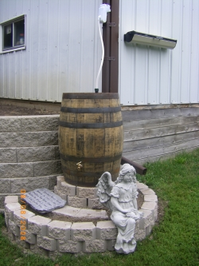
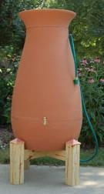
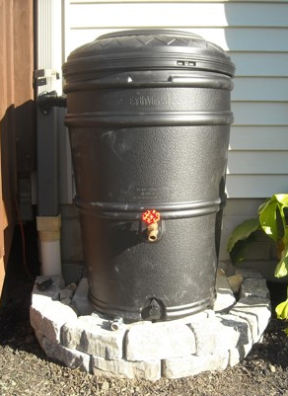
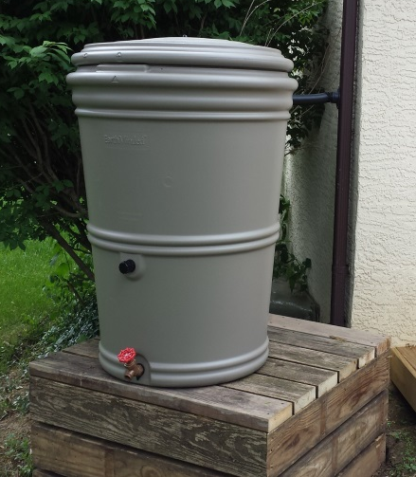
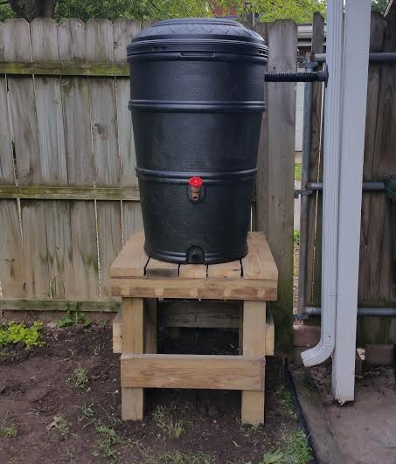
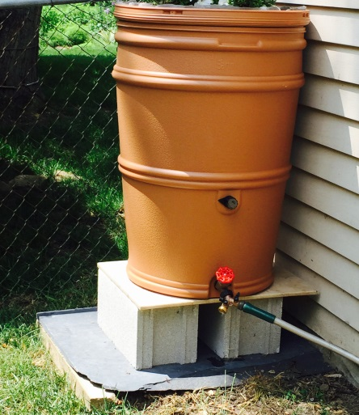
Stands/ Risers
Consider Placement
Elevate slightly for better water pressure
Notes:
Heavy when full: 1 gallon of water weighs over 8 lbs. 45 gal capacity barrel (45 * 8) l= 360 lbs
Ensure level stand, Not top-heavy on platform
Check that it’s Kid-proof and safe (screws to keep lid on)
Elevate at least 2’ for ok water pressure. Pumps are available, however!

Slide 17
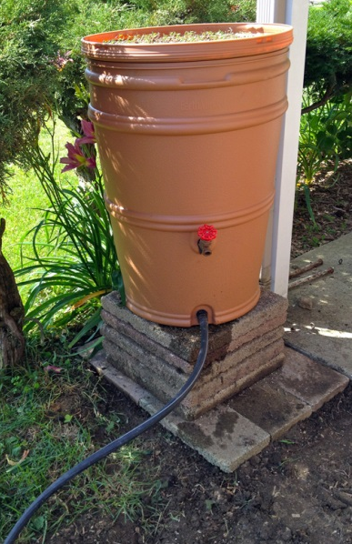
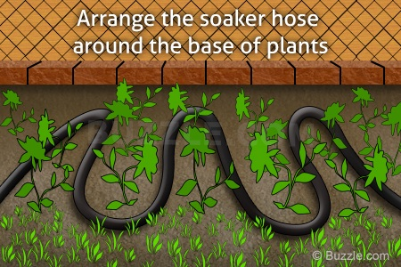
Soaker Hose
Empty Your Barrel for Max Benefit
Notes:
Barrels that are full when it rains can’t capture and store any more rain water.
Keep water flowing by installing a soaker hose to your rain barrel. Less maintenance for you (no open/close valve); consistent free water for your plants

Slide 18
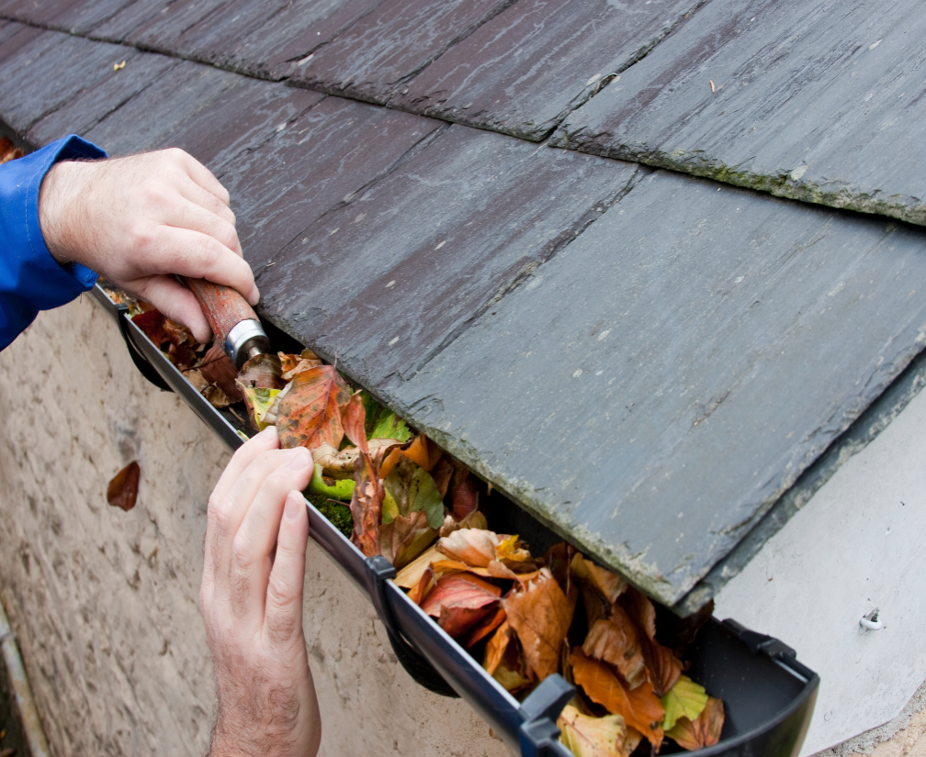
Rain Barrel Maintenance is Minimal
Check during first rain that it’s working properly
Keep gutters cleaned regularly
Use water & drain rain barrel regularly (once a week!)
Store for the winter
Notes:
Store for winter: 1) Empty 2) Clean out 3) Store in shed, garage, basement 4) If kept outside, ensure no water will get in. 5) Plug up downspout.

Slide 19

Water Quality: Rain Barrel
& Rain Garden
You can use a rain barrel and divert the overflow to your rain garden!
Rain gardens typically capture the first inch of rainfall. In central Ohio, we rarely receive more than this during a storm. This “first flush” is responsible for the majority of polluted runoff.

Slide 20
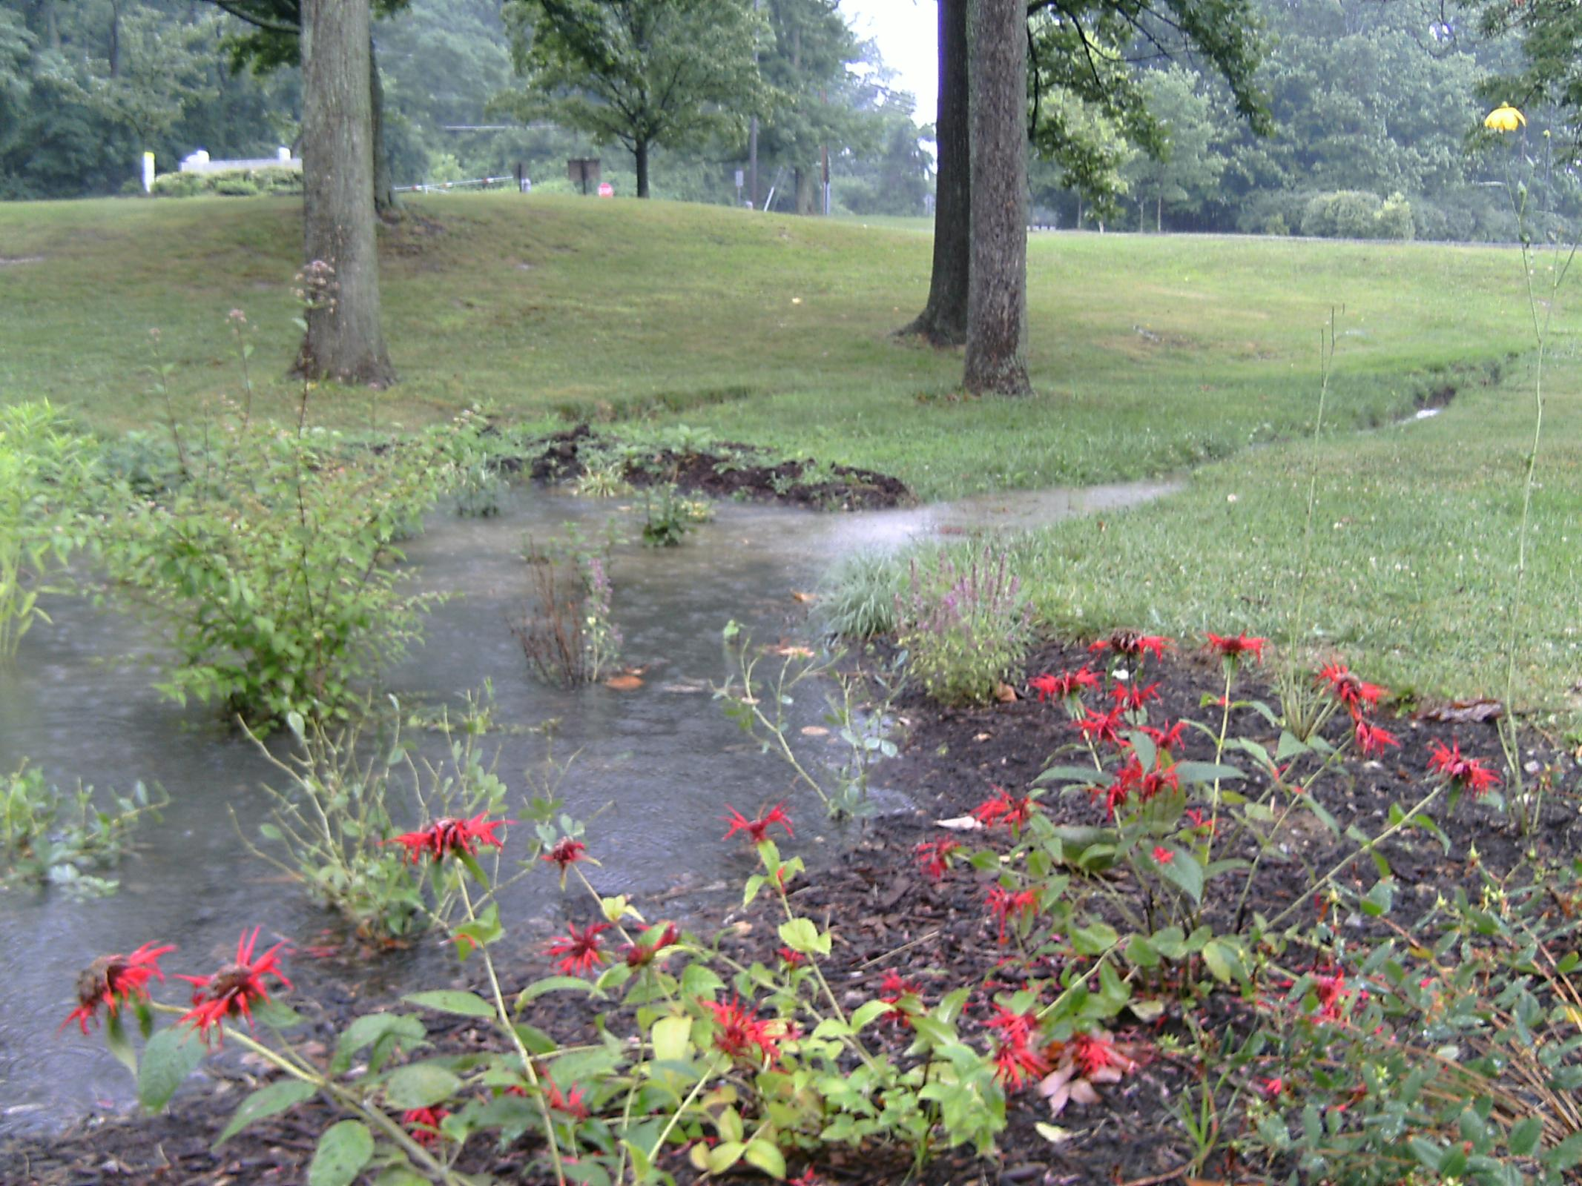
What is a rain garden ?
Stick around after this presentation to learn more about rain gardens and our rain garden cost-share program!
Garden build within a shallow depression
Catches runoff from parking lots, driveways, downspouts, roads, lawns
Water quality, unique landscape feature, habitat
Does not make rain
Is not a pond or water feature
Does not breed mosquitoes
Doesn’t solve drainage problems

Slide 21
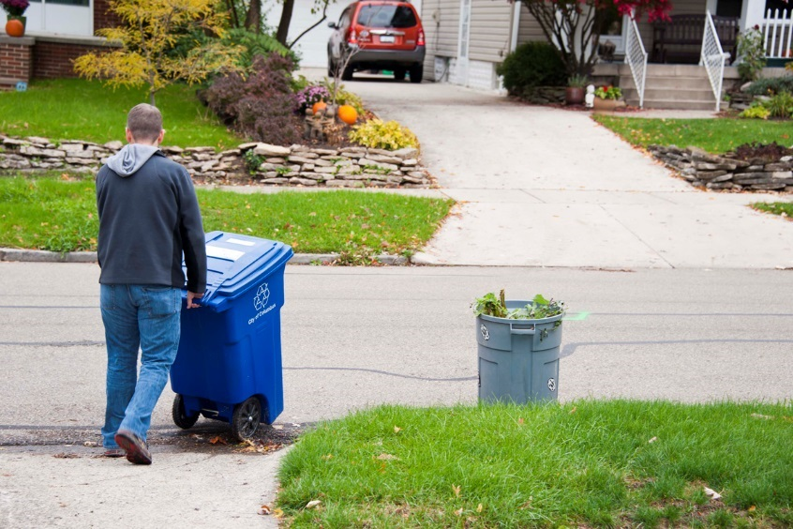
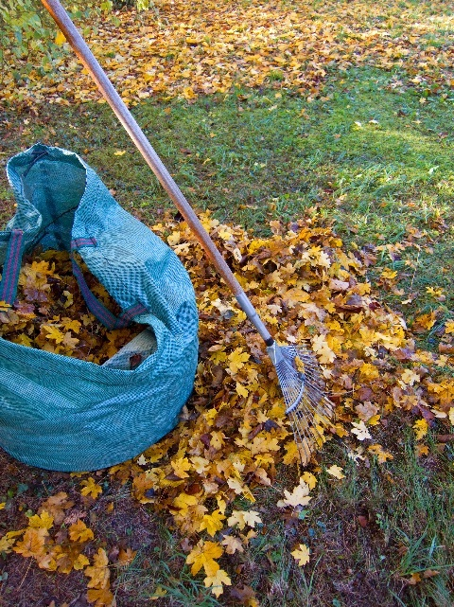

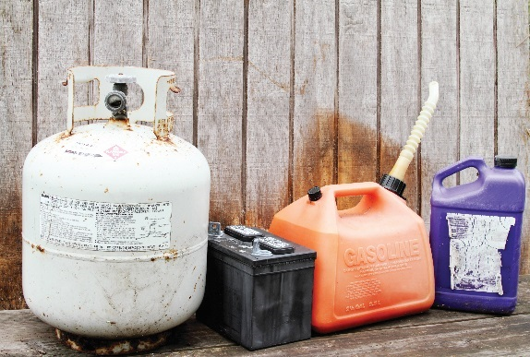
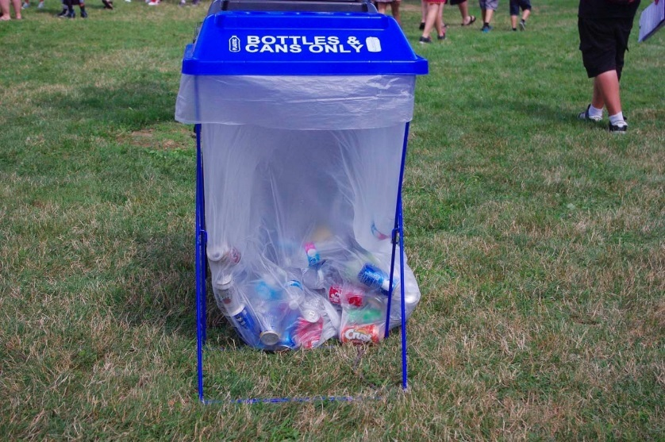

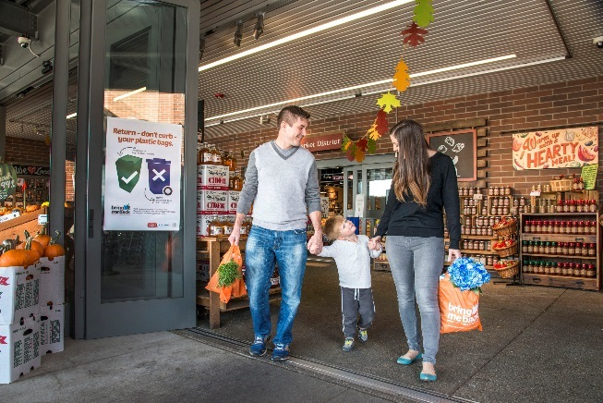
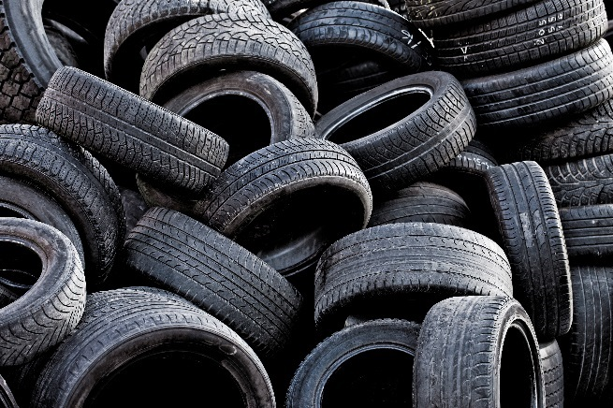

Thank you to SWACO for their partnership for compost bin reimbursements. The next few slides will focus on composting the right material to help decrease the food waste in Franklin County.
Notes:
SWACO is a public agency serving all of Franklin County, and we work to position our region as a leader in environmental sustainability by offering a range of waste reduction, recycling and safe disposal services including:
[[click]] The provision of Recycling Education & Recycling Drop-off containers [[click]] along with the Bring Me Back campaign encouraging residents to recycle plastic bags, film, and wrap while utilizing reusable alternatives whenever possible. [[[click]]]
We sponsor free yard waste composting for Franklin County residents [[[click]]]
and collaborate with law enforcement to reduce illegal dumping.
[[[click]]] Our team helps communities recycle electronics and provides free HHW disposal.
We do own and operate the landfill in FC, so we also offer landfill tours. [[[click]]]
Over 2,000 schools kids came through our landfill tour last year. This is a great opportunity to see what happens when we don’t compost or recycle. [[[click]]]
Our team provides recycling technical assistance and infrastructure to event organizers and community organizations trying to reduce how much they landfill.
More info on all of these programs is available on our new snazzy website swaco.org. [[[click]]]

Slide 22
Every time you eat, you make a choice….
An ounce of prevention is worth a pound of compost
Notes:
But, the exciting part is… Every time you eat, prep, or buy food- you have an opportunity to reduce waste!
There are a few tips and tricks you can use to help you responsibly manage food resources.
The most important first step is to audit Yourself: Look in your landfill or compost bin when you go to toss and consider how waste could be avoided. For example, if you are consistently landfilling wilted basil, consider buying less or learning how to make pesto!
What struggles have you faced at preventing food waste? Do you have any other hacks that help at home?
Now that you have some tools and tricks to help you reduce food waste, let’s talk about what to do with all those food scraps you can’t avoid. Let’s talk about composting.

Slide 23
13% Wasted Food
Notes:
I’m sure you’ve heard mind-blowing stats about food waste nationwide- about 30-40% of what’s produced is never consumed, but how about in our County?
13% of landfilled material in the FCSL is food, which is why prevention is so important.
For a deeper dive into the other materials being landfilled check out SWACO’s recycling 101 workshops!
More info if requested-
Wasted food and yard waste don’t compost per say in the landfill. These organic materials break down slowly in landfills and generate methane gas since the process is without oxygen, or anaerobic. Although the FCSL captures methane and uses it as CNG for the community, it’s still preferred to compost at home because it’s a more local solution that doesn’t require trucking and processing. Thus, composting is your backyard has way fewer emissions than landfilling.

Slide 24
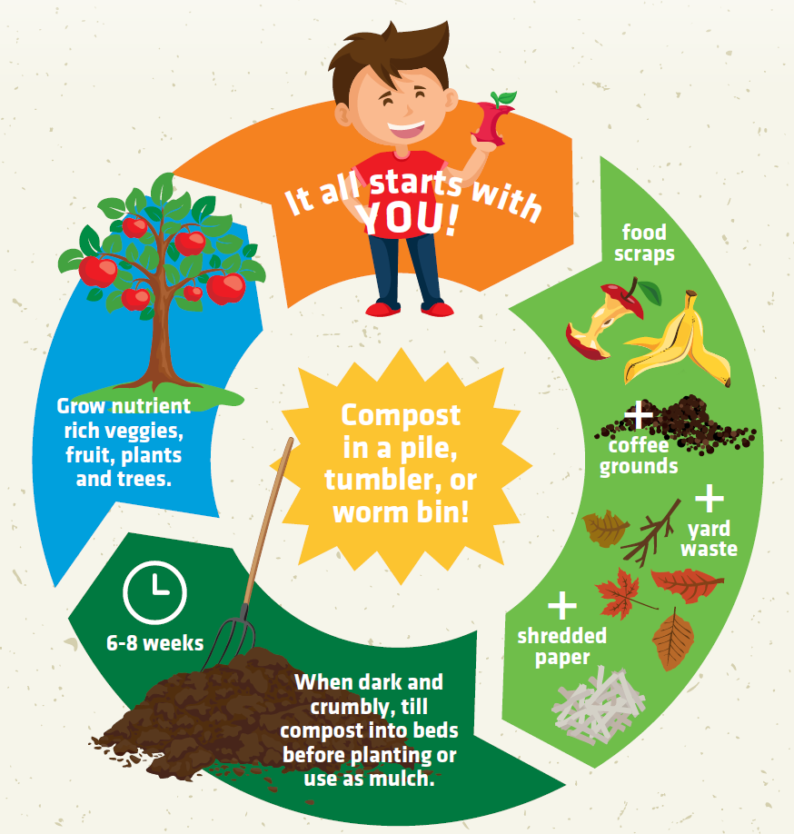

What is Composting?
Notes:
When a tree drops a leaf on the forest floor, its’ not there a few weeks later. This is because the leaf naturally decomposes back into the soil, adding nutrients back to the forest. This closed loop system is how nature was designed to cycle nutrients. Us humans got a little detached from this closed loop system but we are starting to realize we are wasting valuable resources by landfilling food scraps and yard waste.
Compost systems mimic this natural ecosystem of micro-organisms, decomposers, water, and aeration to break your food and yard scraps down into a nutrient-rich additive for your soil.- turning waste to resource. Good ventilation is essential for aerobic decomposition and a healthy environment for worms.

Slide 25
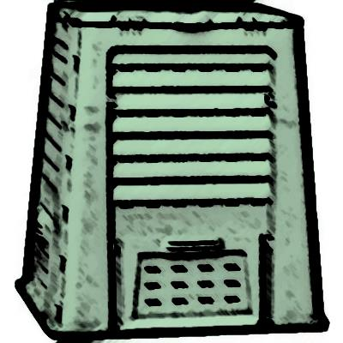
Benefits of Composting
Buffers pH
Tastier fruits and veggies (higher sugar content)
Better soil structure and drainage
No amount of fertilizer can make up for poor soil!
Reduces food and yard waste
Increases water-holding capacity
Notes:
Also acts as soil inoculant- less fertilizers and pesticides. Slow-release “fertilizer” –like amendment.

Slide 26










Compostable material is all around you
“Browns”: bulky, tough, dry, fibrous materials provide carbohydrates (carbon)
Carbon provides the energy food for microorganisms
A little weathered is best!
“Greens”: fresh, green, wet materials provide protein (nitrogen)
Nitrogen materials provide protein that microorganisms need to break down the carbon food
Bury and cover food scraps to deter rodents
To grow and multiply, composting organisms need 4 things:
carbon, nitrogen, oxygen, and moisture.

Slide 27

Notes:
Let’s talk a little more about what goes into composting. Covering up our nitrogen rich items like food scraps with the dried out organic matter like dead leaves helps keep the chemistry aligned for fast, smell-free decomposition. Another way to think about the greens and the browns are to consider what is and is not burnable- the browns are easily burnable while the greens aren’t typically.
Make sure you don’t poison your worms by accidentally adding dangerous chemicals. We suggest not adding plants you don’t want to repopulate in your yard because you may end up spreading the seeds when you use your compost.

Slide 28








Composting Size, Air, Water
1 cubic yard is ideal
If too small, your compost won’t hold enough heat.
If too large, air won’t penetrate the pile.
3 feet
3 feet
3 feet
Efficient bacteria need oxygen!
Add a coarse layer to the bottom of the pile
Add ventilation with perforated PVC pipe, wire mesh cylinders, or metal pipes
Use an aerator tool
3 feet
Too little moisture slows decomposition and too much is suffocating
Your pile should be about as moist as a wrung-out sponge
Rainwater is best!

Slide 29


Composting: Temp and Turning
Fever!
Excessive heat above 150° will kill beneficial bacteria
150° F
Avoid weed seeds and disease.
Or ensure it reaches at least 130° for a few days.
130° F
When to turn ?
Whenever the temperature drops below 100°.
Every 6 weeks to 3 months is good, too
Ideal temperatures: 90° - 150° F
100° F
Notes:
Turning your pile ensures you’re mixing well-rotted materials with fresh, green material and dry stuff with wet stuff. How often you turn your pile is up to you and when you’d like finished compost!

Slide 30







Composting Containers
Enclosed: Rollers, Tumblers, Bins*
*
These kinds of containers (many brands and models available) are eligible for rebates through Community Backyards

Slide 31


On-the-Ground Containers
Require Rodent Proof Bottoms

Slide 32



Vermicomposting
Composting- But With Worms!
Vermicomposting: using the efficiency of worms to turn food scraps into rich soil additive
Notes:
Fill an opaque ventilated bin 1/3 to 1/2 full with moist (not dripping) cardboard or newspaper as bedding.
Place Red Wriggler worms in the middle of the bedding and cover.
Set bin with worms and bedding in a place that’s 55-80 F for about a week.
After a week start adding food scraps (Up to 3.5 pounds for each 1 pound of worms) to your worm bin once each week. Layer in “browns” as you would with normal compost.
Harvest castings every 2-6 months (When the material smells earthy rather than like old food). Move most old material to one side of the bin and place new bedding and fresh food on the other side. Over a few days your worms will migrate to the new material and anything old can be harvested.

Slide 33


Intro to Worm Parenthood
Red Wrigglers—start with 1 lbs. ~1000 worms
No thermostat wars—ideal temp 55-80 degrees
Wet the skin to let oxygen in
3.5 lbs. food: 1 lbs. worms/week
Bite size portions easily digestible

Slide 34






Building A Home For Your Worms
Start with bedding—fill bin ½ full moist paper
Add worms in middle of bedding
Adjustment: 1 week left alone to feed on bedding
Layer with food scraps and newspaper
Layering with browns--super important keep odors down!
No earthworms! Red worms are best.
3.5 lbs food / 1 lb worms / week
Freeze scraps to keep smells under wraps

Slide 35


: A More Healthy Lawn
Lawncare & Landscape
Q:
Why are grass clippings and leaf litter harmful to our lakes, streams, and rivers?
Yard waste, like fertilizer, contains nutrients including phosphorus and nitrogen. When mismanaged and dumped in creeks as pictured here, those nutrients contribute to unwanted, uncontrolled growth of algae and invasive aquatic weeds.
A:
Excess algae can lead to the deoxygenation of water and potential fish kills. It looks unsightly and reduces opportunities for recreation and swimming.

Slide 36




Lawncare & Landscape
Visit getgrassy.org to learn more
What you do in the comfort of you yard affects our local waterways!
Leaf it on your lawn
Stay hydrated
Notes:
Lawn care is a source of non-point source pollution under the Ohio and federal EPA.
Leafcycle: grasscycle and mulch fall leaves back onto lawn to slowly improve topsoil so your lawn absorbs more stormwater.
Water: 1”water per week in summer. OK to let established lawns go dormant.

Slide 37




Lawncare & Landscape
Visit getgrassy.org to learn more
Soak it in
Mow to grow
Choose fall
Notes:
Soak it in: with rain barrel and rain garden
Mow to grow: more frequently in spring, so that you don’t clip grass too short, stressing the plant and weakening grass. Take off no more than 1/3 of blade at time. Let it go too long while out on vacation? Cut it back in phases.
Choose fall: University research shows the best time to fertilize your lawn is in the fall, while it’s cooler and establishing healthy roots. Important to keep it off hard surfaces and use recommended amount.
Ask them to take pledge in booklet and we’ll send them a prize!! Whoooo

Slide 38



Water Quality: Native Plants
Fall
Fall
Summer
Goldenrods and asters provide fall color and nectar. Can you count the pollinators on this goldenrod?
Spring
Blazing star is common in both home and commercial landscapes.
Jack-in-the-pulpit, a ephemeral (short-lived) spring wildflower.
Perennials come back year after year. They’re adapted to local conditions including weather, insects, and soils.

Slide 39



Native Plants & Insects
1
2
2
3
Few insects can feed on milkweed. Pictured are a monarch caterpillar and milkweed beetle.
Hummingbird moth visits blue lobelia in rain garden.
Spicebush swallowtail butterflies need host plants for their larvae.
“Because food for all animals starts with energy harnessed by plants, the plants we grow in our gardens have the critical role of sustaining, directly or indirectly, all the animals with which we share our living spaces.” –D. Tallamy, Bringing Nature Home- How You Can Sustain Wildlife with Native Plants

Slide 40







Native Plants
Red maple
Ohio buckeye (also plays football)
Paw paw
1
Flowering dogwood
Buttonbush
Black gum
River birch
A native plant is one that occurs naturally in a particular region, ecosystem, or habitat without direct or indirect human action. We consider the flora present at the time Europeans arrived in North America as the species native to the eastern United States.
Central Ohio has a rich variety of native wildflowers, trees,
and shrubs for every landscape!

Slide 41












Invasive Plants
Community Backyards will not offer rebates for invasive vegetation, including their cultivars
Amur honeysuckle
Garlic mustard
Purple loosestrife
Tree of heaven
Japanese knotweed
Lesser celandine
The majority of invasive plant species in Ohio’s natural areas are non-native. Invasive species threaten our environment and economy. Avoid them and practice removal and replacement.

Slide 42




Quick Recap
UN-
Eligible Items for Reimbursement
Notes:
Presenter to cover: Voucher & eligibility questions, VOUCHER Expiration (60 Days)!!! Rebate process- 2 ways (immediate vendor/mail-in rebate.

Slide 43


Thank you for participating in Community Backyards!
Visit
www.franklinswcd.org/documents/presentations
To view this and other related presentations
Contact Franklin Soil and Water
Mail: 1404 Goodale Blvd., Suite 100, Columbus, OH 43212
(614) 486-9613
franklinswcd.org
communitybackyards.org
Related Projects: getgrassy.org  centralohioraingardens.org
Administered by:

